Slide 1


Facebook Ad Benchmarking Tool
Edwin Tam Wei Ching | - | A0178396J
Lin Jun Liang | - | A0178295M

Slide 2

Recap…

Slide 3
What gets clicks on a social media advertisement?

Slide 4
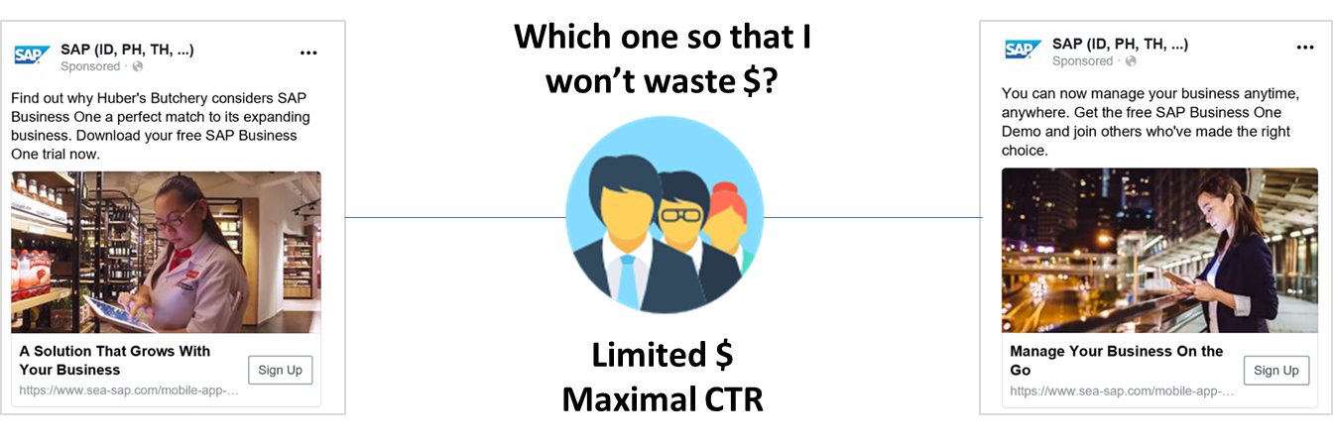
Predict a social media advertisement’s click-throughs before it goes live

Slide 5
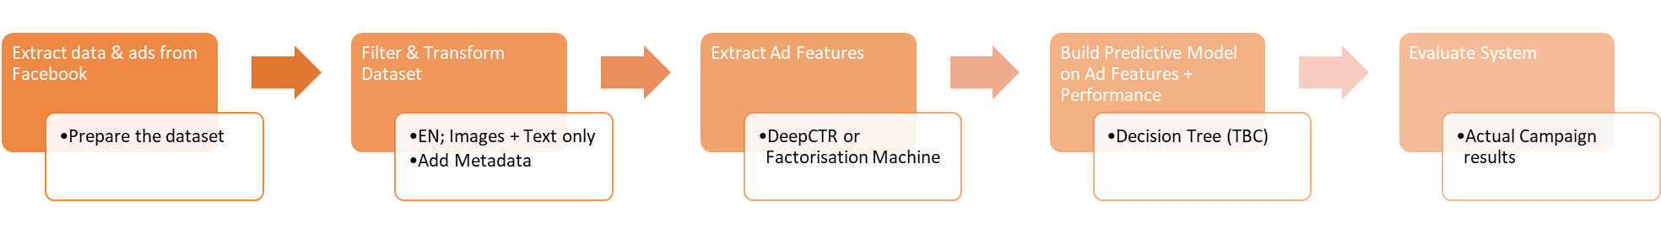
SVM
Neural Network
Extract & transform past data from social media platforms
Ads and ad performance data is contained on social media platforms. They are our data source for this system.
Extract ad features for prediction use
“Recognize" image elements and text in the ad. Image elements could be people, car, etc. These elements are then used – in conjunction with ad performance data – to train the system and predict on new ads.
Predict a close enough Cost-Per-Click (CPC) / Click-Through-Rate (CTR)
The final output of this system. We define “close enough” as 70% to 80% of the actual CPC/CTR

Slide 6
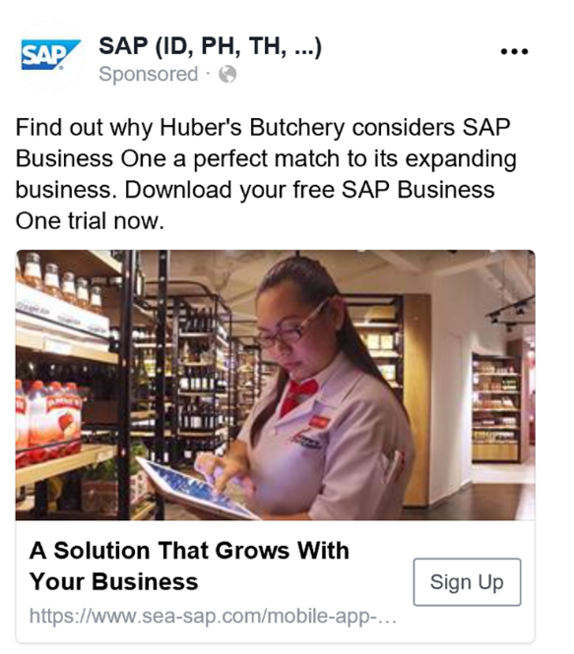
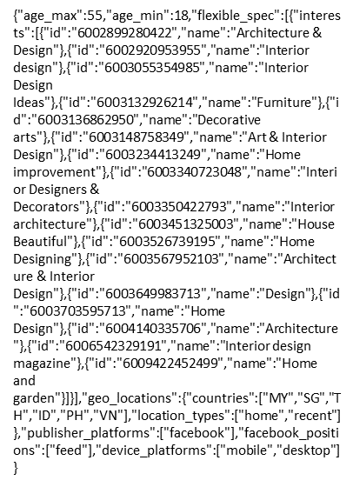
SVM
Neural Network
Extract & transform past data from social media platforms
Extract ad features for prediction use
Predict a close enough Cost-Per-Click (CPC) / Click-Through-Rate (CTR)
CTR: 1.2%
CPC: $0.45
Ad
Targeting parameters

Slide 7

Progress…

Slide 8

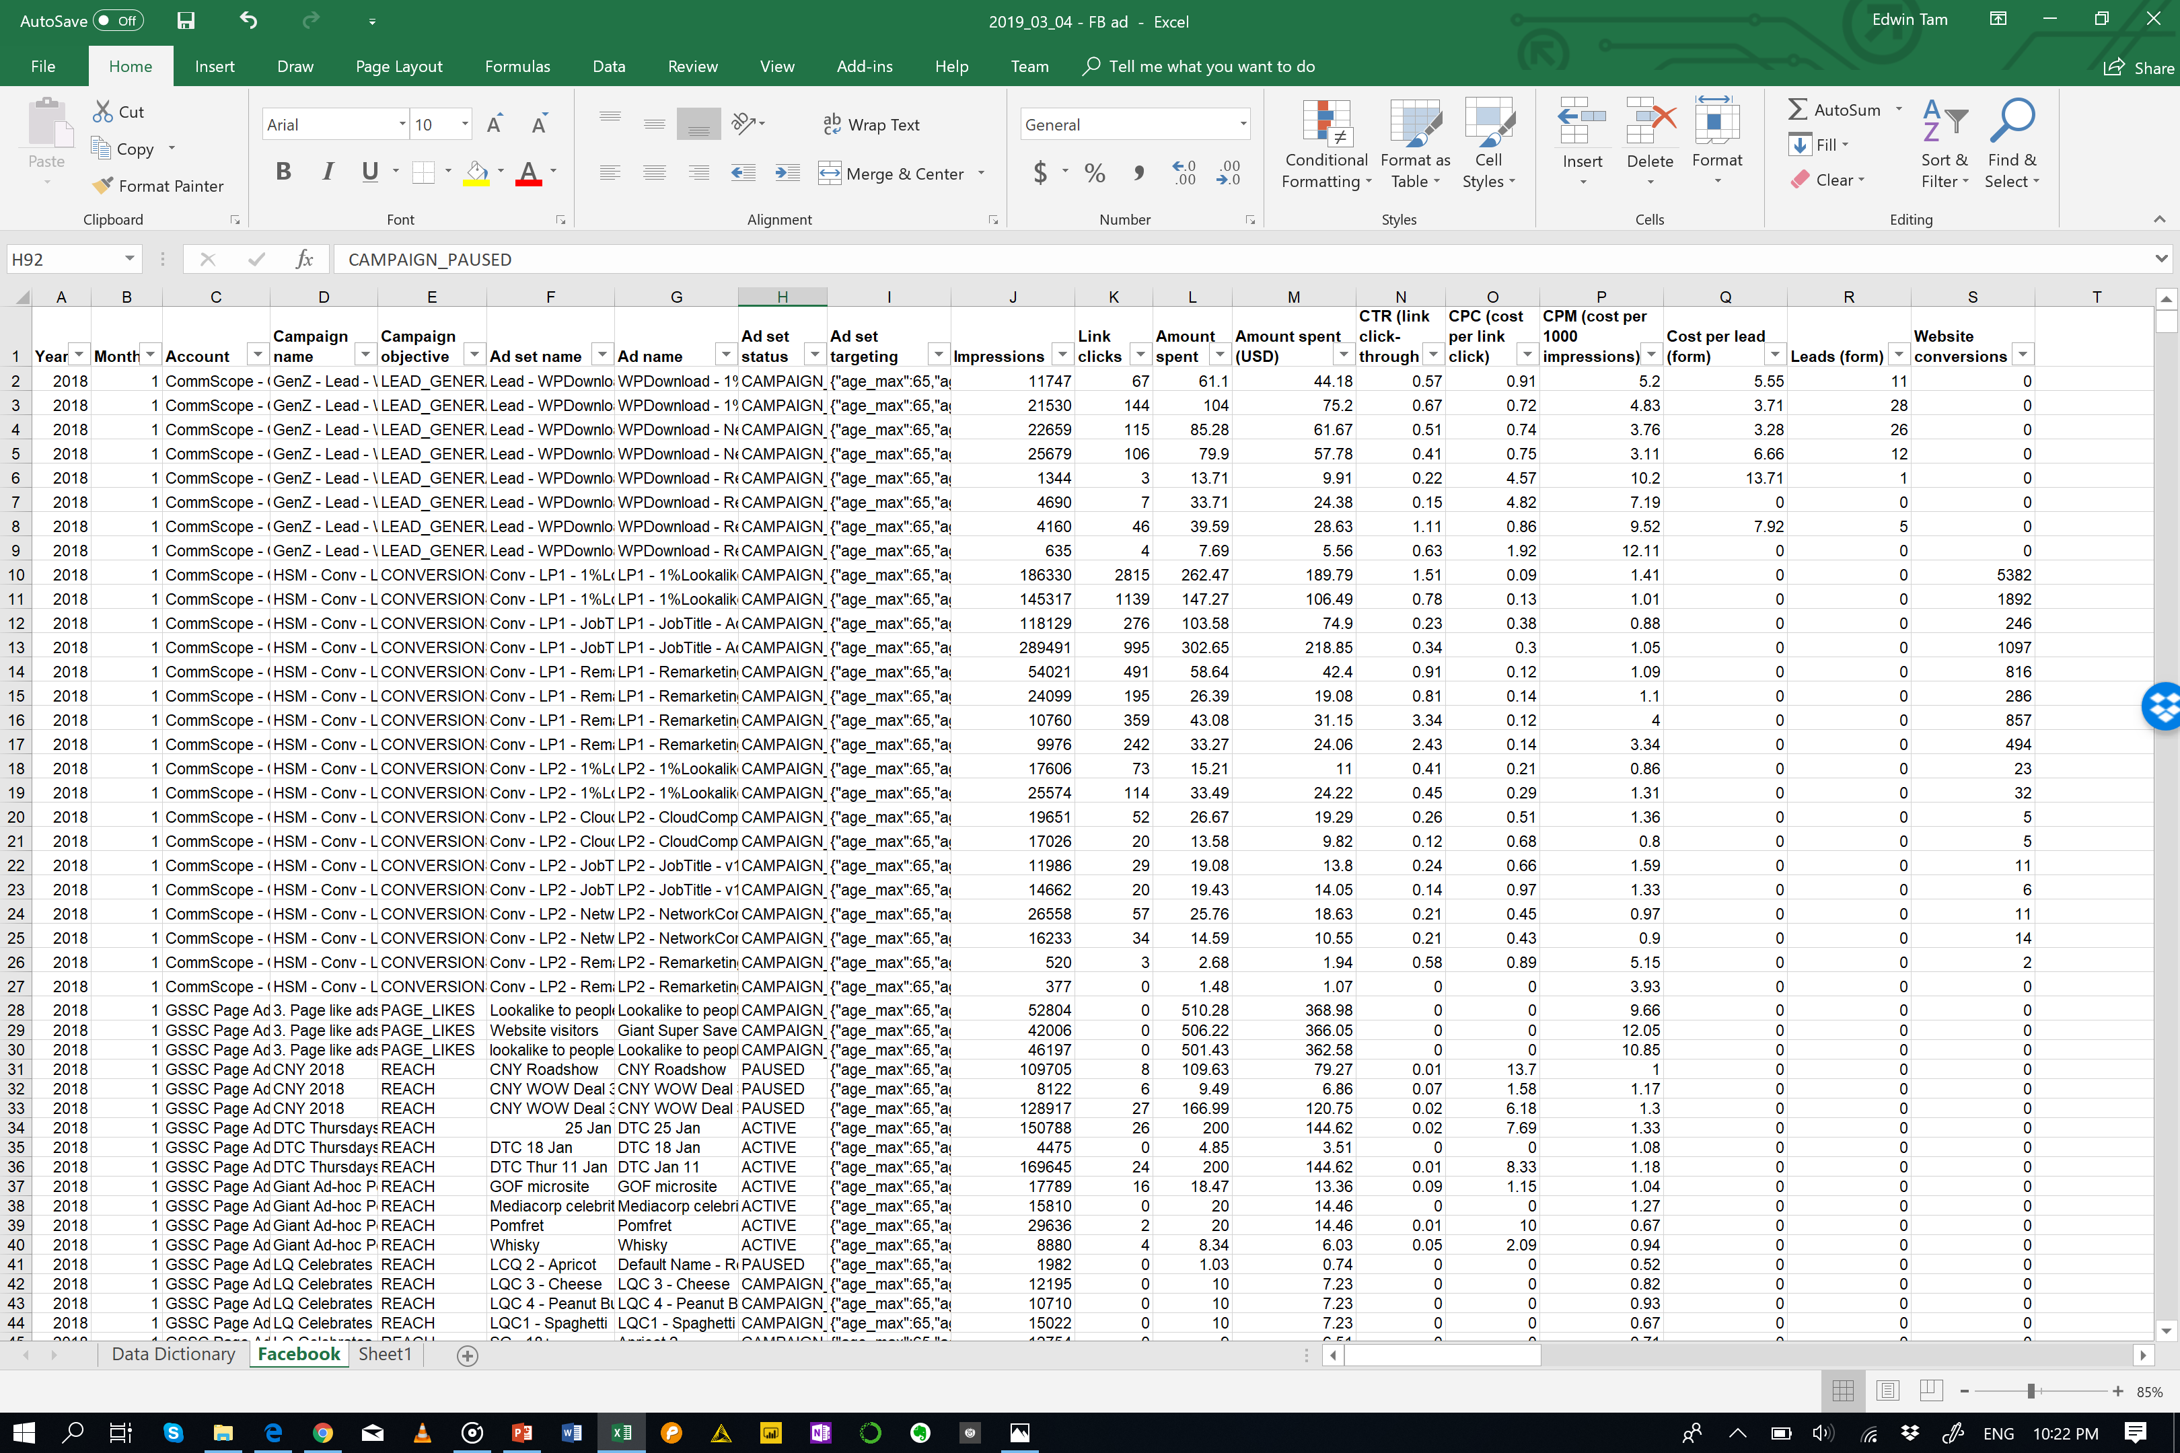
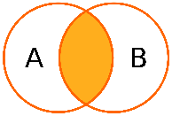


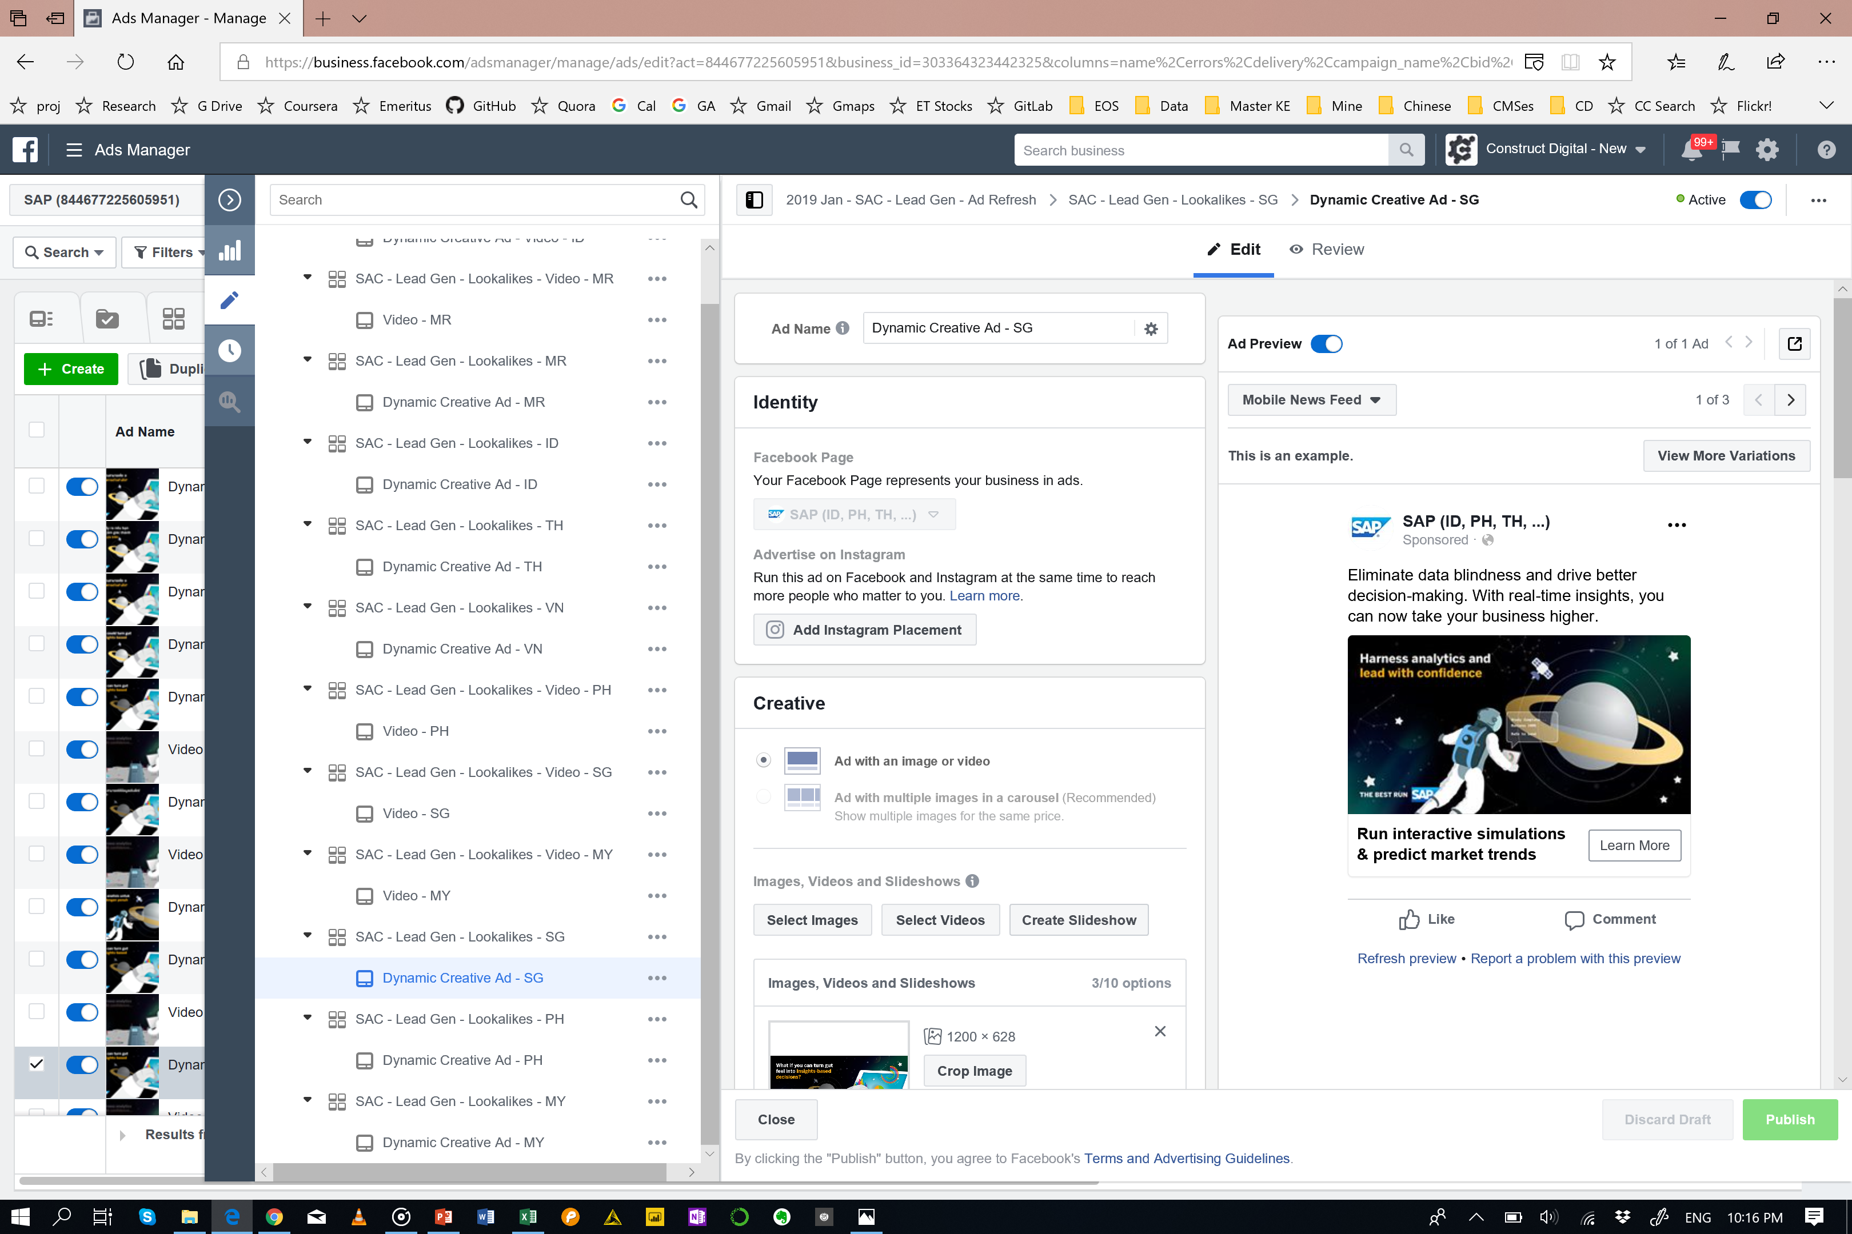

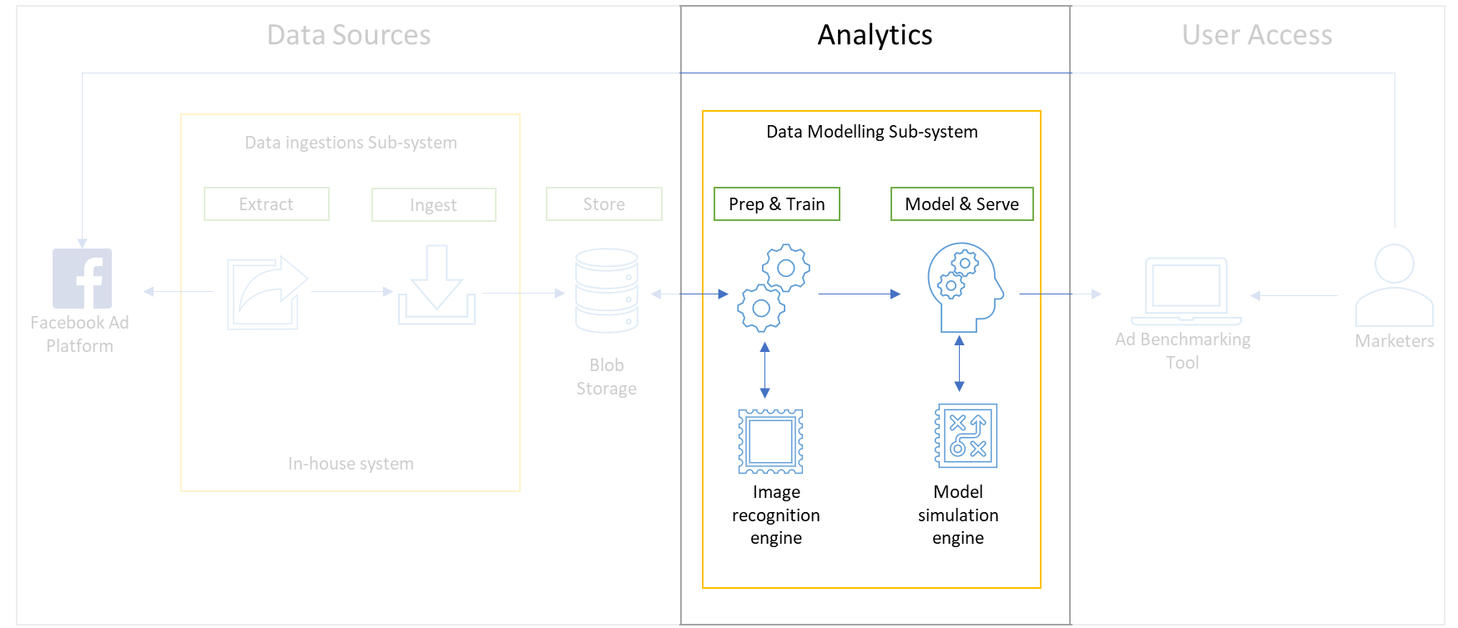
System Process
Remove Video Ads
Est 2% of dataset
1
Ad Performance
7
Transform via Python
JOIN Ad Performance + Ad Targeting + Ad Images + Text
Data Pre-processing
Model Training
4
Add Metadata
Industry; company type
2
Select only English ads
8
Train and save
the best models
3
Break up Targeting into discrete variables
Age; gender country; interests; exclusions;
Data Lake
Extract Ad Features
Ad Images + Text
5
Extract Ad image features and classify images
9
Models ready to be use by marketers
6
Extract meaning from body text & headlines

Slide 9
Methods
Video ads data is removed
Only English ads data are extracted
Ads targeting criteria will be categorized accordingly
Adding meta data to enrich the dataset with information such as industry, company type and size etc…
Appropriate methods will be used to extract ads features from the images
Texting mining techniques to be used to extract meaning from the ad text (optional for now)
The pre-processed data will then be saved back to the data lake / local storage
The processed data will be used to for model training with several machine learning algorithm
The trained models are then saved and ready to be used by marketers

Slide 10
System Process
Remove Video Ads
Est 2% of dataset
1
Ad Performance
7
Transform via Python
JOIN Ad Performance + Ad Targeting + Ad Images + Text
Data Pre-processing
Model Training
4
Add Metadata
Industry; company type
2
Select only English ads
8
Train and save
the best models
3
Break up Targeting into discrete variables
Age; gender country; interests; exclusions;
Data Lake
Extract Ad Features
Ad Images + Text
5
Extract Ad image features and classify images
9
Models ready to be use by marketers
6
Extract meaning from body text & headlines

Slide 11

Challenges

Slide 12



High feature dimensionality & sparsity
510 Interests
203 Work Positions
52 Image Features

Slide 13
High feature dimensionality & sparsity
510 Interests
203 Work Positions
52 Image Features
Contextual Overlaps?
Reduce Dimensionality?

Slide 14

Would individual feature classes do well in predicting ad performance?

Slide 15
Would individual feature classes do well in predicting ad performance?
Linear Regression
Mixed Input Models

Slide 16
Our models aren’t very accurate
 | Results
Model | CPC (Features) | CTR (Features)
Linear Regression (Interest) | 0.1146 (48) | 0.1463 (59)
Linear Regression (Work) | 0.1318 (18) | 0.0149 (28)
Linear Regression (Location) | 0.0949 (36) | 0.09492 (36)
Linear Regression (Images) | 0.01499 | 0.01499
Linear Regression (Interest + Work) | 0.1162 (59 + 18) | 0.1457 (59 + 18)
Linear Regression (Work + Country) | 0.2219 (28 + 36) | 0.1071 (28 + 36)
Linear Regression (Interest + Country) | 0.2605 (59 + 36) | 0.1986 (59 + 36)
Linear Regression (Interest + Work + Country) | 0.2465 (48 + 28 + 36) | 0.2643 (59 + 18 + 36)
Mixed Input Model (see “Combine all feature categories) | 0.01017 (ic1) | 0.057944 (iwc1)
The best feature combination only answers 0.2465 of variance.

Slide 17

Implementation

Slide 18



Phases
Exploratory Data Analysis
Extract , Clean, Transform
Predict

Slide 19
Exploratory Data Analysis

Slide 20
Data Exploration & Understanding
Columns names | Description
Year | String/
Month | String/
Account | String/ Account name as stated in FB Ad manager
Campaign name | String/ Same as in FB Ad manager
Campaign objective | String/
Ad set name | String/ Same as in FB Ad manager
Ad name | String/ Same as in FB Ad manager
Ad set status | String/ Same as in FB Ad manager
Ad set targeting | String/ The targeting when setting up the ad on FB
Impressions | Integer/
Link clicks | Integer/
Amount spent | Float/
Amount spent (USD) | Float/
CTR (link click-through rate) | Float/
CPC (cost per link click) | Float/
CPM (cost per 1000 impressions) | Float/
Cost per lead (form) | Float/
Leads (form) | Integer/
Website conversions | Integer/
Facebook Ad Data Dictionary

Slide 21
Data Exploration & Understanding
Columns names | Description
Year | String/
Month | String/
Account | String/ Account name as stated in FB Ad manager
Campaign name | String/ Same as in FB Ad manager
Campaign objective | String/
Ad set name | String/ Same as in FB Ad manager
Ad name | String/ Same as in FB Ad manager
Ad set status | String/ Same as in FB Ad manager
Ad set targeting | String/ The targeting when setting up the ad on FB
Impressions | Integer/
Link clicks | Integer/
Amount spent | Float/
Amount spent (USD) | Float/
CTR (link click-through rate) | Float/
CPC (cost per link click) | Float/
CPM (cost per 1000 impressions) | Float/
Cost per lead (form) | Float/
Leads (form) | Integer/
Website conversions | Integer/
What observation can we use?
What do we need to “break apart”?
Facebook Ad Data Dictionary

Slide 22
Data Exploration & Understanding
Columns names | Description
Year | String/
Month | String/
Account | String/ Account name as stated in FB Ad manager
Campaign name | String/ Same as in FB Ad manager
Campaign objective | String/
Ad set name | String/ Same as in FB Ad manager
Ad name | String/ Same as in FB Ad manager
Ad set status | String/ Same as in FB Ad manager
Ad set targeting | String/ The targeting when setting up the ad on FB
Impressions | Integer/
Link clicks | Integer/
Amount spent | Float/
Amount spent (USD) | Float/
CTR (link click-through rate) | Float/
CPC (cost per link click) | Float/
CPM (cost per 1000 impressions) | Float/
Cost per lead (form) | Float/
Leads (form) | Integer/
Website conversions | Integer/
What observation can we use?
What do we need to “break apart”?
Investigation | Results
Total Observations | 3,347
English Ads with Actual-sized images | 2,061 (~61%)
Break down of English Ads | +----+---------+---------+ | | Type | Count | |----+---------+---------| | 0 | SHARE | 1918 | | 1 | INVALID | 91 | | 2 | PAGE | 52 | +----+---------+---------+
Total appropriate images | 2,207
English, non-video ads with larger than thumbnail sized image
Facebook Ad Data Dictionary

Slide 23
Data Exploration & Understanding
Columns names | Description
Year | String/
Month | String/
Account | String/ Account name as stated in FB Ad manager
Campaign name | String/ Same as in FB Ad manager
Campaign objective | String/
Ad set name | String/ Same as in FB Ad manager
Ad name | String/ Same as in FB Ad manager
Ad set status | String/ Same as in FB Ad manager
Ad set targeting | String/ The targeting when setting up the ad on FB
Impressions | Integer/
Link clicks | Integer/
Amount spent | Float/
Amount spent (USD) | Float/
CTR (link click-through rate) | Float/
CPC (cost per link click) | Float/
CPM (cost per 1000 impressions) | Float/
Cost per lead (form) | Float/
Leads (form) | Integer/
Website conversions | Integer/
What observation can we use?
What do we need to “break apart”?
Facebook Ad Data Dictionary

Slide 24
Data Exploration & Understanding
Columns names | Description
Year | String/
Month | String/
Account | String/ Account name as stated in FB Ad manager
Campaign name | String/ Same as in FB Ad manager
Campaign objective | String/
Ad set name | String/ Same as in FB Ad manager
Ad name | String/ Same as in FB Ad manager
Ad set status | String/ Same as in FB Ad manager
Ad set targeting | String/ The targeting when setting up the ad on FB
Impressions | Integer/
Link clicks | Integer/
Amount spent | Float/
Amount spent (USD) | Float/
CTR (link click-through rate) | Float/
CPC (cost per link click) | Float/
CPM (cost per 1000 impressions) | Float/
Cost per lead (form) | Float/
Leads (form) | Integer/
Website conversions | Integer/
What observation can we use?
What do we need to “break apart”?
Facebook Ad Data Dictionary

Slide 25
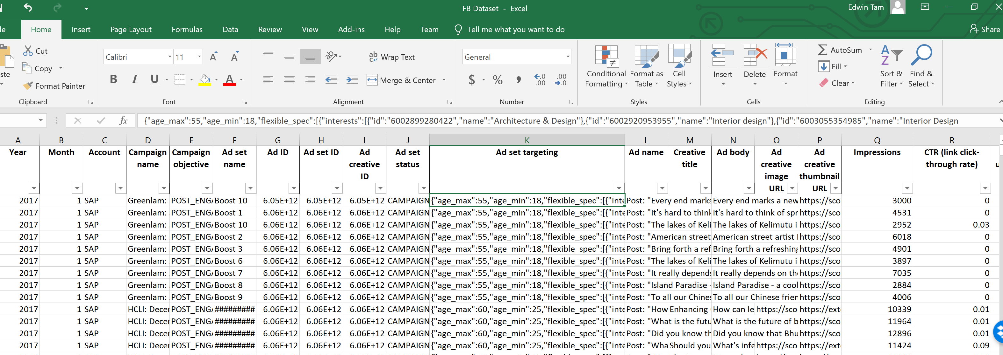
Data Exploration & Understanding
{"age_max":60,"age_min":25,"flexible_spec":[{"interests":[{"id":"6003371567474","name":"Entrepreneurship"},{"id":"6003402305839","name":"Business"},{"id":"6004037932409","name":"Management"}]},{"education_majors":[{"id":"105612759471878","name":"Human resource management"},{"id":"107550232608120","name":"Leadership studies"},{"id":"112307425448585","name":"Industrial and organizational psychology"},{"id":"112892498724794","name":"Management"}],"work_positions":[{"id":"103113219728224","name":"Chief executive officer"},{"id":"104033229633392","name":"Human resources"},{"id":"104133639622995","name":"Talent manager"},{"id":"105612759471878","name":"Human resource management"},{"id":"108595432498170","name":"Senior management"},{"id":"113084235408104","name":"HR & Administration Manager"},{"id":"116885444988542","name":"Director general"},{"id":"134403556642798","name":"Chief human resources officer"},{"id":"210836798933397","name":"Gerente general"},{"id":"330512057159170","name":"Human Resource Director"},{"id":"330839220446732","name":"Sales Director"},{"id":"659208810873456","name":"Human Resources Director (HR Director)"},{"id":"921392397900832","name":"Human Resources Administrator"}]}],"geo_locations":{"countries":["SG"],"location_types":["home","recent"]},"publisher_platforms":["facebook"],"facebook_positions":["feed","right_hand_column"],"device_platforms":["mobile","desktop"]}
“Ad set targeting” contains ad targeting parameters

Slide 26
Extract , Clean, Transform

Slide 27



Extract, Clean, Transform
Google Cloud Vision
Azure Cognitive Services
imageAI
Notes:
Filter for English, non-video ads with larger-than-thumbnail-sized images
Add meta data to enrich the dataset with information such as industry, company type and size etc…
Extract & Categorise Image & Target parameters features
Source, Trial, Decide on Image Identification model
Perform feature engineering or dimensionality reduction (Feature Hashing, Classify-and-categorise, PCA)
Texting mining techniques to be used to extract meaning from the ad text (optional for now)

Slide 28
Extract, Clean, Transform
Supports image prediction and training using 4 different Machine Learning algorithms trained on the ImageNet-1000 dataset.
Supports object detection, video detection and object tracking using RetinaNet, YOLOv3 and TinyYOLOv3 trained on COCO dataset.
Able to train custom models for performing recognition of new objects
Google Cloud Vision
Azure Cognitive Services
imageAI

Slide 29
Extract, Clean, Transform
Identifiable Objects:
person, bicycle, car, motorcycle, airplane, bus, train, truck, boat, traffic light, fire hydrant, stop sign, parking meter, bench, bird, cat, dog, horse, sheep, cow, elephant, bear, zebra, giraffe, backpack, umbrella, handbag, tie, suitcase, frisbee, skis, snowboard, sports ball, kite, baseball bat, baseball glove, skateboard, surfboard, tennis racket, bottle, wine glass, cup, fork, knife, spoon, bowl, banana, apple, sandwich, orange, broccoli, carrot, hot dog, pizza, donot, cake, chair, couch, potted plant, bed, dining table, toilet, tv, laptop, mouse, remote, keyboard, cell phone, microwave, oven, toaster, sink, refrigerator, book, clock, vase, scissors, teddy bear, hair dryer, toothbrush
Google Cloud Vision
Azure Cognitive Services
imageAI

Slide 30


Extract, Clean, Transform
yolo-tiny.h5
yolo.h5
resnet50_coco_best_v2.0.1.h5
DenseNet-BC-121-32.h5
squeezenet_weights_tf_dim_ordering_tf_kernels.h5
resnet50_weights_tf_dim_ordering_tf_kernels.h5
inception_v3_weights_tf_dim_ordering_tf_kernels.h5

Slide 31
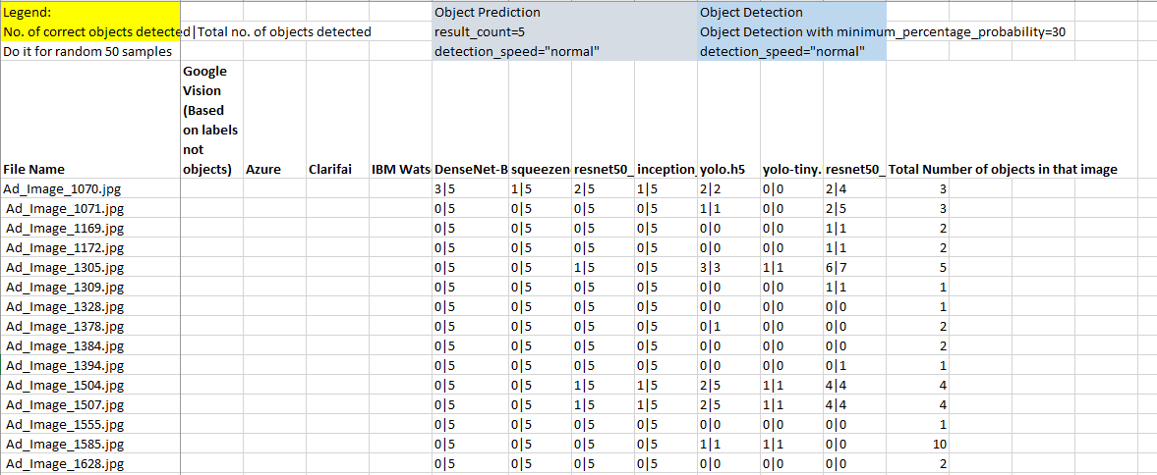
Extract, Clean, Transform
Model selection based on 50 random samples
Full results: https://www.dropbox.com/s/i5q9bagyzvo6imn/Test%20results.xlsx?dl=0

Slide 32
Extract, Clean, Transform
Model selection based on 50 random samples
DenseNet-BC-121-32.h5Prediction models perform really bad on ads
YOLO-Tiny predicts lesser objects compared to YOLO.h5 and resnet50_coco_best_v2.0.1.h5 predicts more objects compared to YOLO
Full results: https://www.dropbox.com/s/i5q9bagyzvo6imn/Test%20results.xlsx?dl=0

Slide 33
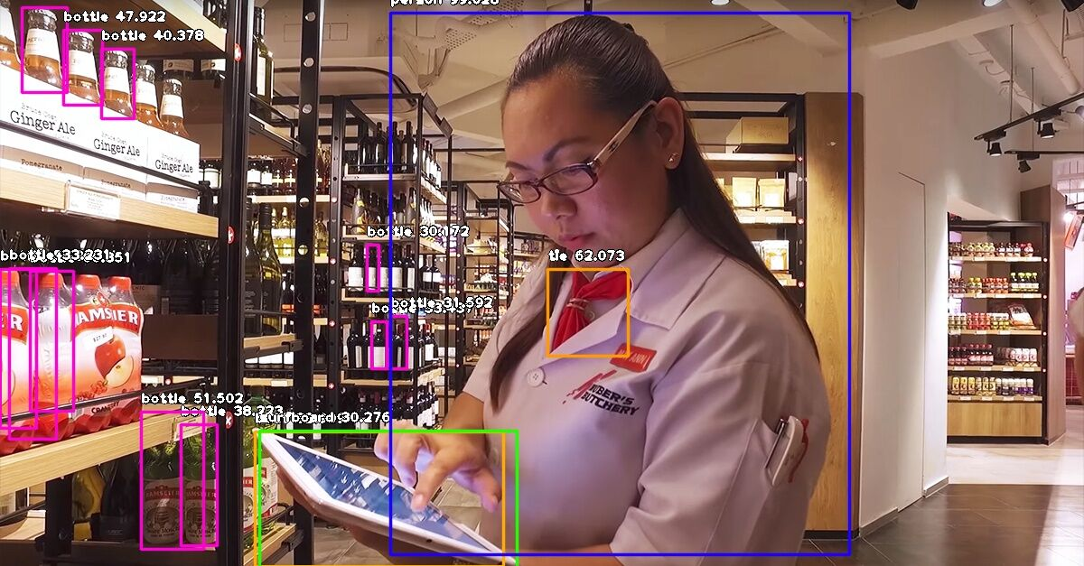
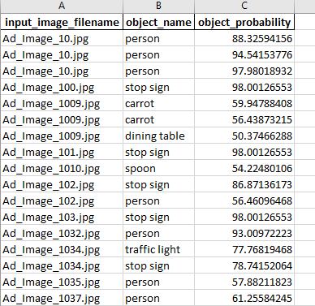

Extract, Clean, Transform
resnet50_coco_best_v2.0.1.h5 (~4 hours) 2207 images , 6298 objected identified

Slide 34
Extract, Clean, Transform
resnet50_coco_best_v2.0.1.h5 (~4 hours) 2207 images , 6298 objected identified
The results data are then transpose and match with the image file name into the Facebook data file
Link to the combined file

Slide 35
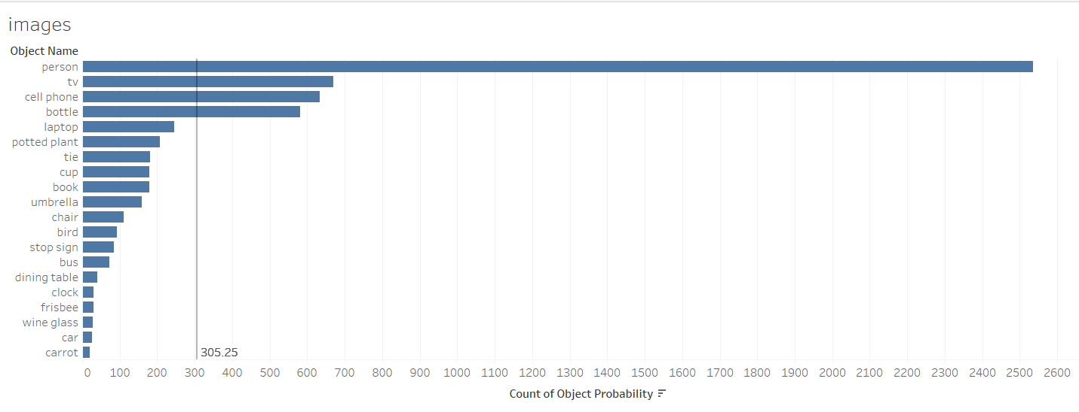
Extract, Clean, Transform
Object Frequency Distribution across images
53 unique objects identified in 2,061 ad images. The most detected objects are:
Person
TV
Cell phone
Bottle
Laptop

Slide 36
Extract, Clean, Transform
Object Frequency Distribution across images
Would prediction models be confounded by the “Person” skew in the object frequency distribution?
Should we feature hash images?
53 unique objects identified in 2,061 ad images. The most detected objects are:
Person
TV
Cell phone
Bottle
Laptop

Slide 37
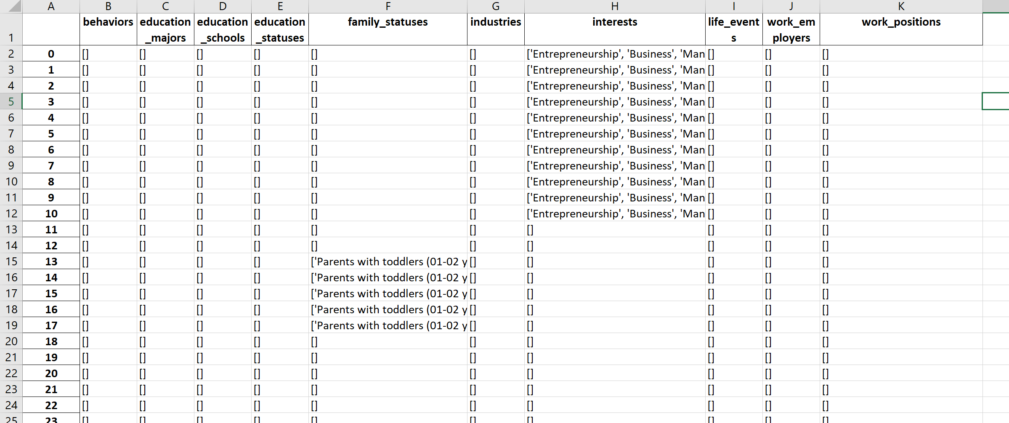
Extract, Clean, Transform
Broken Up Ad Targeting Parameters
Large volume of features: 510 Interests, 203 Work Positions, and 52 Image Objects, and the need to use these parameters as model inputs.

Slide 38
Extract, Clean, Transform
Broken Up Ad Targeting Parameters
Encode parameters using 1-hot encoding
Reduce dimensionality for Interests & Work Positions via
Feature Hashing FeatureHasher from Scikit-learn
Categorise-and-Cluster Manually categorise & use KNN to cluster
PCA Decomposition from Scikit-learn
Large volume of features: 510 Interests, 203 Work Positions, and 52 Image Objects, and the need to use these parameters as model inputs.

Slide 39
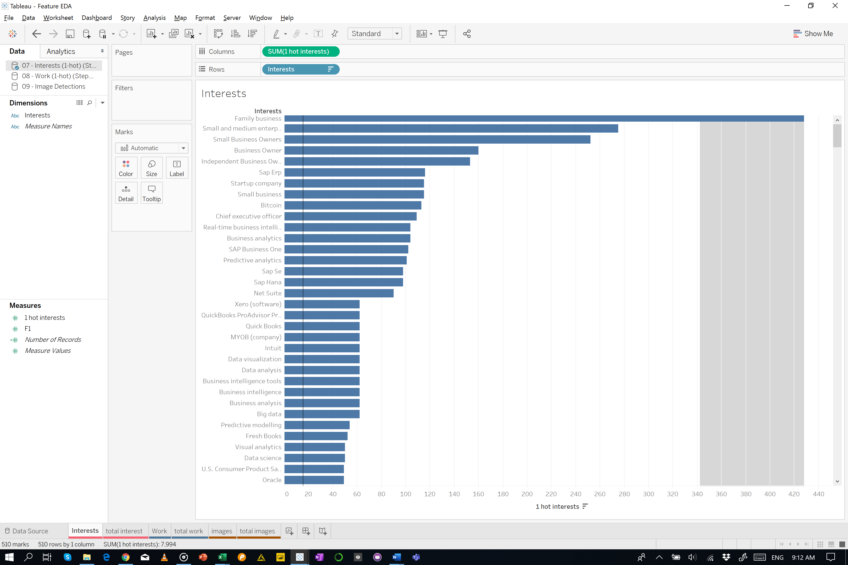
Extract, Clean, Transform
Interests Frequency Distribution
510 unique “interests” for 2,601 ads. The top interests are:
Family business
Small and medium enterprise
Small business owner
business owner
independent business

Slide 40
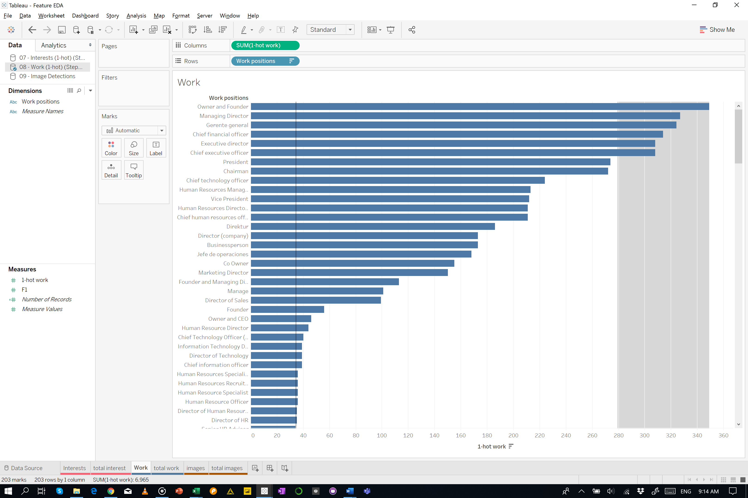
Extract, Clean, Transform
Work Position Frequency Distribution
203 unique “Work Positions” for 2,601 ads. The top “work positions” are:
Owner and founder
Managing director
Gerente general
Chief Financial Officer
Executive Director

Slide 41
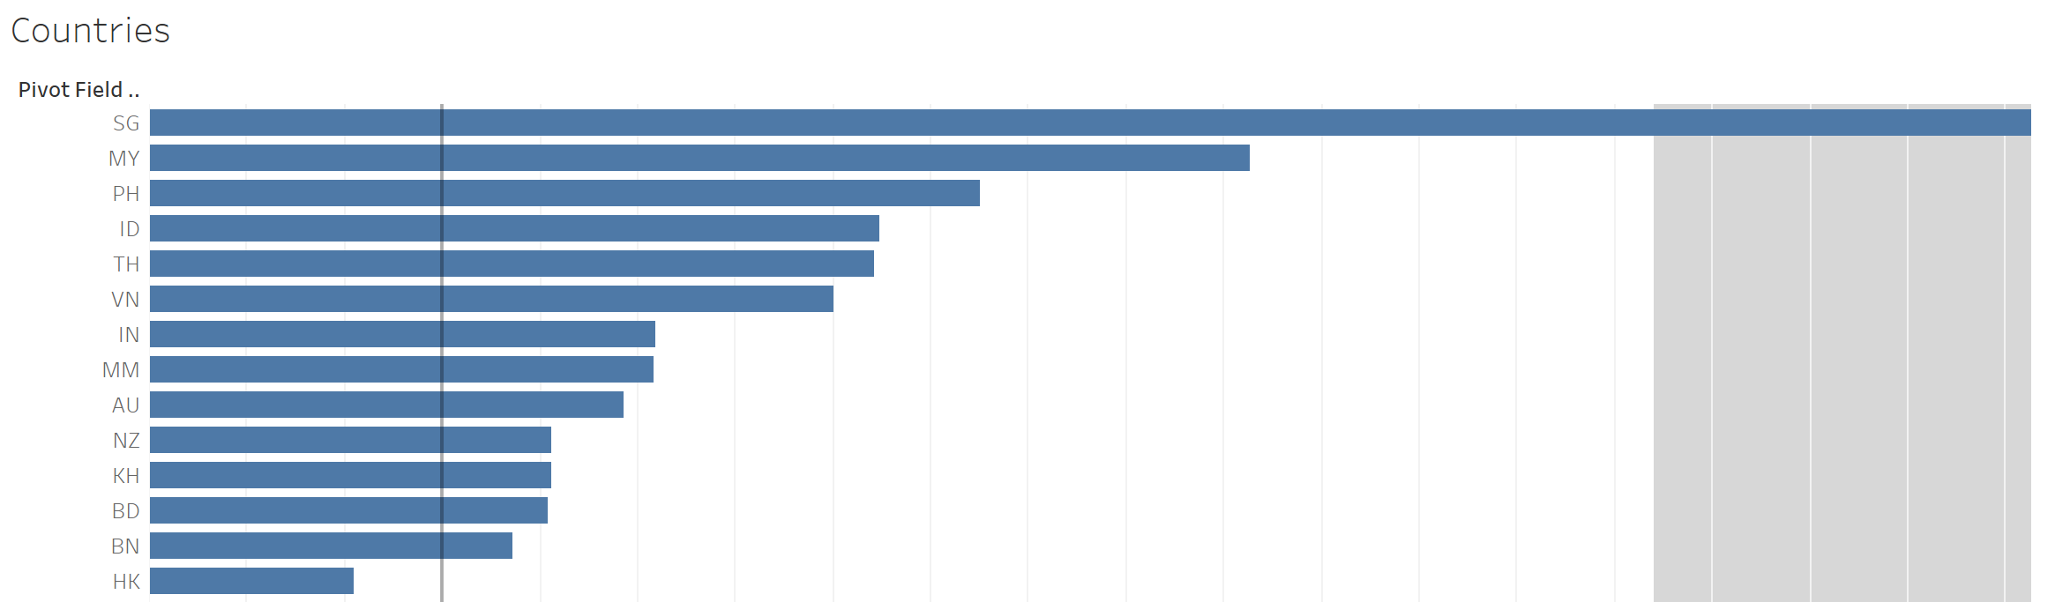

Extract, Clean, Transform
Interests Frequency Distribution
36 unique “Countries” for 2,601 ads. The top “Countries” are:
SG
MY
PH
ID
TH

Slide 42
Extract, Clean, Transform
Method | Why | How
Feature Hashing FeatureHasher from Scikit-learn (how to) | Signed hash function – ensure less collisions and accumulations of error Mitigate size of large dummied datasets by dropping zeros (reduce sparsity) Achieves same score with respect to working with sparse matrix but half the work & smaller memory footprint | Run the 1-hot encoded features through FeatureHasher Because FeatureHasher needs to know N features to collapse, we can generate a long list of hashed features (currently 1…N/2 of feature set). Test best feature # by running it through linear regressors
Categorise-and-Cluster Manually categorise & use KNN to cluster | Similar interests belong under broad categories People with similar interests may be attracted to similar things May be highly correlated — reduces multicollinearity in the model | Manually classify interests Run classified interests through KNN (using Euclidean distance)
PCA (in progress) Decomposition from Scikit-learn | Similar reasons to Feature Hashing | Run the 1-hot encoded features through PCA Decomposition. Look for 95% covariance.

Slide 43
Extract, Clean, Transform
Method | Why | How
Feature Hashing FeatureHasher from Scikit-learn (how to) | Signed hash function – ensure less collisions and accumulations of error Mitigate size of large dummied datasets by dropping zeros (reduce sparsity) Achieves same score with respect to working with sparse matrix but half the work & smaller memory footprint | Run the 1-hot encoded features through FeatureHasher Because FeatureHasher needs to know N features to collapse, we can generate a long list of hashed features (currently 1…N/2 of feature set). Test best feature # by running it through linear regressors
Categorise-and-Cluster Manually categorise & use KNN to cluster | Similar interests belong under broad categories People with similar interests may be attracted to similar things May be highly correlated — reduces multicollinearity in the model | Manually classify interests Run classified interests through KNN (using Euclidean distance)
PCA (in progress) Decomposition from Scikit-learn | Similar reasons to Feature Hashing | Run the 1-hot encoded features through PCA Decomposition. Look for 95% covariance.

Slide 44
Extract, Clean, Transform
Method | Why | How
Feature Hashing FeatureHasher from Scikit-learn (how to) | Signed hash function – ensure less collisions and accumulations of error Mitigate size of large dummied datasets by dropping zeros (reduce sparsity) Achieves same score with respect to working with sparse matrix but half the work & smaller memory footprint | Run the 1-hot encoded features through FeatureHasher Because FeatureHasher needs to know N features to collapse, we can generate a long list of hashed features (currently 1…N/2 of feature set). Test best feature # by running it through linear regressors
Categorise-and-Cluster Manually categorise & use KNN to cluster | Similar interests belong under broad categories People with similar interests may be attracted to similar things May be highly correlated — reduces multicollinearity in the model | Manually classify interests Run classified interests through KNN (using Euclidean distance)
PCA (in progress) Decomposition from Scikit-learn | Similar reasons to Feature Hashing | Run the 1-hot encoded features through PCA Decomposition. Look for 95% covariance.

Slide 45
Extract, Clean, Transform
Linear Regression
Red = < 0; Green = best performance
All CTR & CPC were normalized before regression took place.

Slide 46
Predict

Slide 47
Predict
Feature Hasher
Notes:
Run prediction models (Linear Regression) on images objects, interests, work positions, and locations. Compare results to inform Extract, Clean & Transform (3b)
Combine all feature categories. Run into Mixed Input Model.

Slide 48
Predict
Feature Hasher
How much reduction is considered “good”?
Notes:
Run prediction models (Linear Regression) on images objects, interests, work positions, and locations. Compare results to inform Extract, Clean & Transform (3b)
Combine all feature categories. Run into Mixed Input Model.

Slide 49
Predict
Feature Hasher
How much reduction is considered “good”?
Create a list of features for both Interest & Work positions [min= 1; max = N/2]
Run it through linear regressions on CPC & CTR (70% train; 30% test)
Pick a set of feature numbers that seem to work
Use this subset of features in Mixed Input Model
Notes:
Run prediction models (Linear Regression) on images objects, interests, work positions, and locations. Compare results to inform Extract, Clean & Transform (3b)
Combine all feature categories. Run into Mixed Input Model.

Slide 50
Predict
Feature Hasher
How much reduction is considered “good”?
Create a list of features for both Interest & Work positions [min= 1; max = N/2]
Run it through linear regressions on CPC & CTR (70% train; 30% test)
Pick a set of feature numbers that seem to work
Use this subset of features in Mixed Input Model
Results suggest that we should focus on fewer than 59 Interest Hashed Features & 28 Work Hashed Features
Notes:
Run prediction models (Linear Regression) on images objects, interests, work positions, and locations. Compare results to inform Extract, Clean & Transform (3b)
Combine all feature categories. Run into Mixed Input Model.

Slide 51
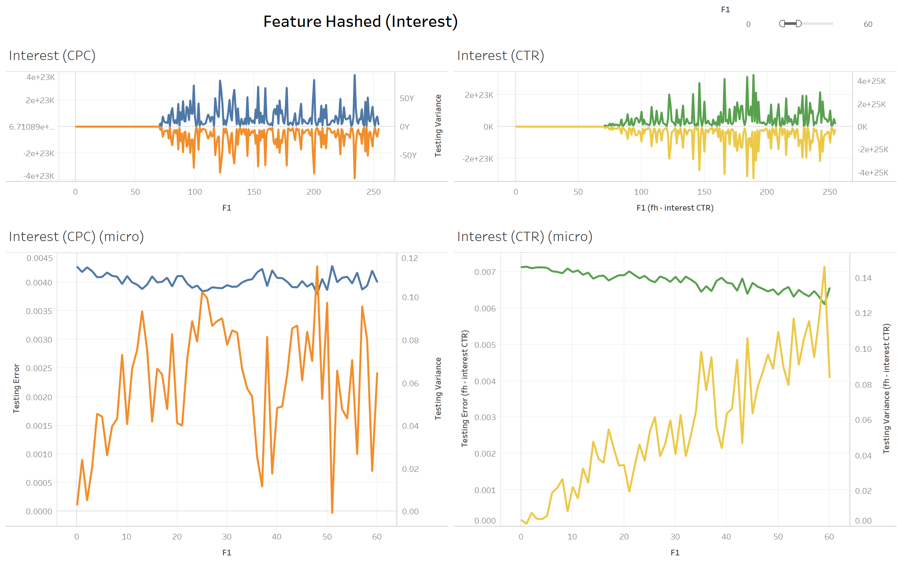
Predict
Linear Regression on Interests (Feature Hashed)

Slide 52
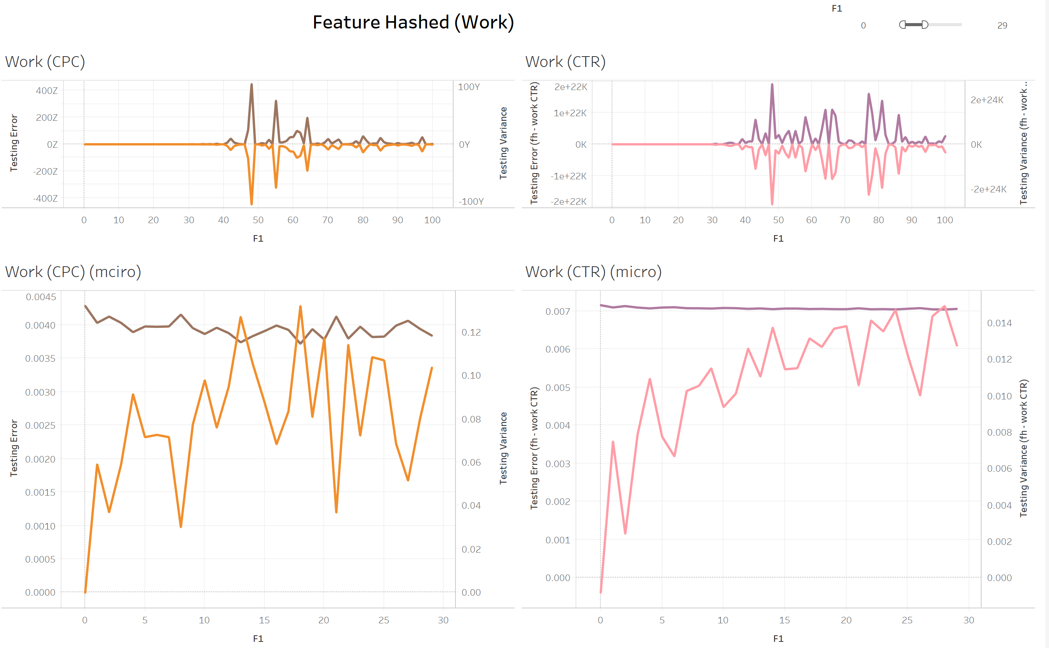
Predict
Linear Regression on Work Positions (Feature Hashed)

Slide 53
Predict
Would we do better if we combined our targeting parameters?

Slide 54
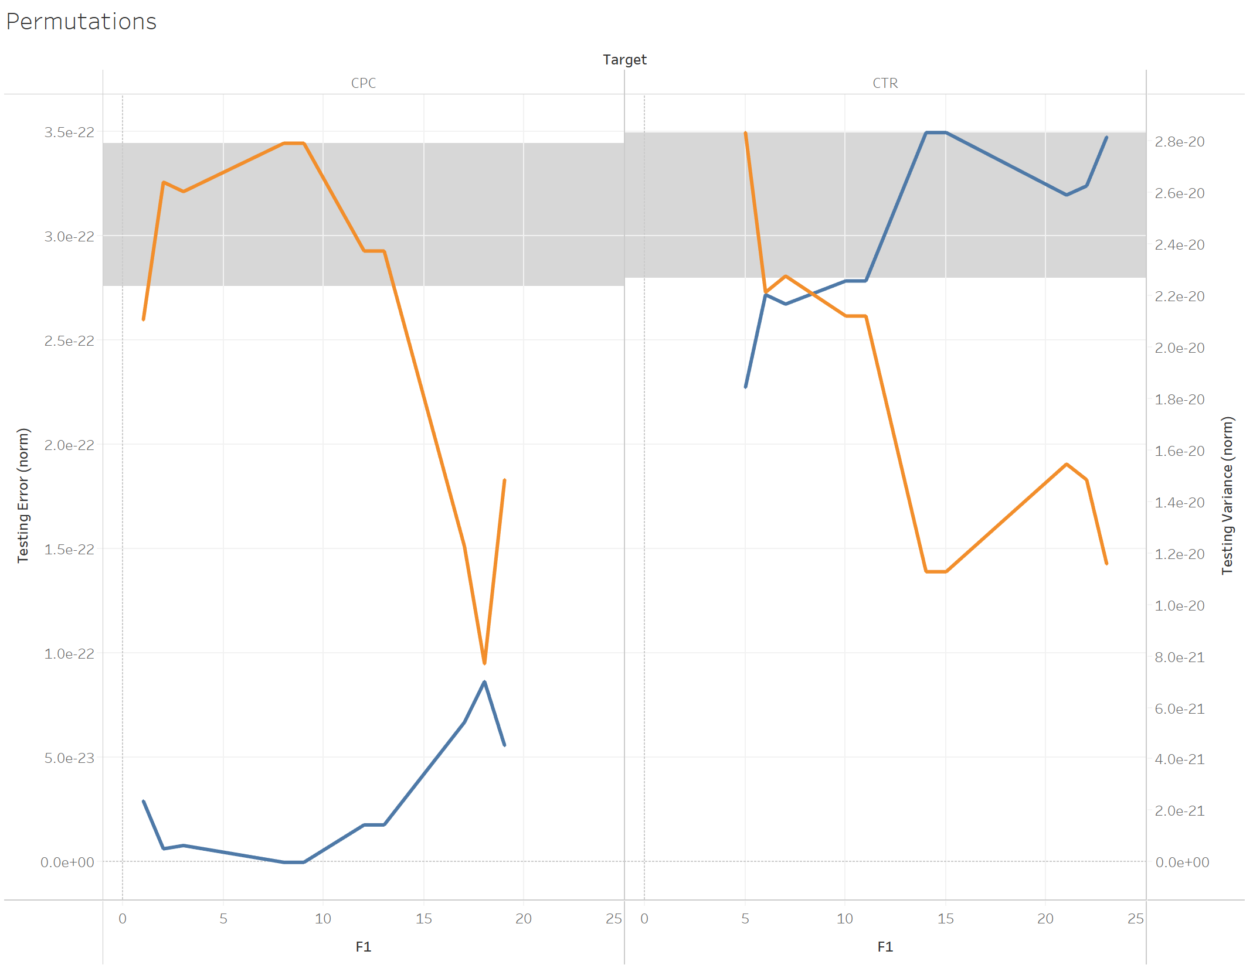
Predict
Would we do better if we combined our targeting parameters?
Linear Regression on Interests (FH) X Work (FH) X Countries (Not FH)
FH = Feature Hashed

Slide 55
Predict
Linear Regression
Table: Linear Regression on Interests X Work (Feature Hashed) X Countries (Not Feature Hashed)

Slide 56
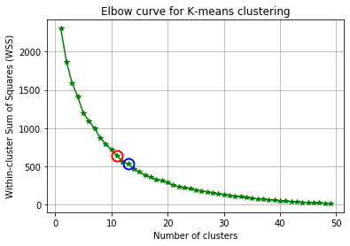
Predict
Categorize-and-Cluster with KNN
Running these clusters through the Linear Regressor gave an R Squared value: 0.1703.

Slide 57
Predict
1: Interest, Work, or Countries (3)
2: Interest and Work, or Interest and Countries, or Work and Countries (3)
3: Interest, Work, and Countries (1)
For each point, we ran the outputs into a linear regressor (CTR or CPC) to get the results.
PCA (In Progress…)

Slide 58
Predict
1: Interest, Work, or Countries (3)
2: Interest and Work, or Interest and Countries, or Work and Countries (3)
3: Interest, Work, and Countries (1)
For each point, we ran the outputs into a linear regressor (CTR or CPC) to get the results.
PCA
Table: Linear Regression on Interests X Work X Countries (PCA)

Slide 59
Predict
Do we actually need to reduce dimensionality?

Slide 60
Predict
Do we actually need to reduce dimensionality?
How correlated are the features?
If we can find the correlation ratio between features,
We could probably use K-means to cluster them.
Or remove variables that are highly correlated to enforce independence

Slide 61
Predict
Do we actually need to reduce dimensionality?
How correlated are the features?
If we can find the correlation ratio between features,
We could probably use K-means to cluster them.
Or remove variables that are highly correlated to enforce independence
Could we group work positions into broader categories (e.g. seniority) and use label (aka dummy) encoding on them?
This would obey ordinality and reduce dimensionality

Slide 62
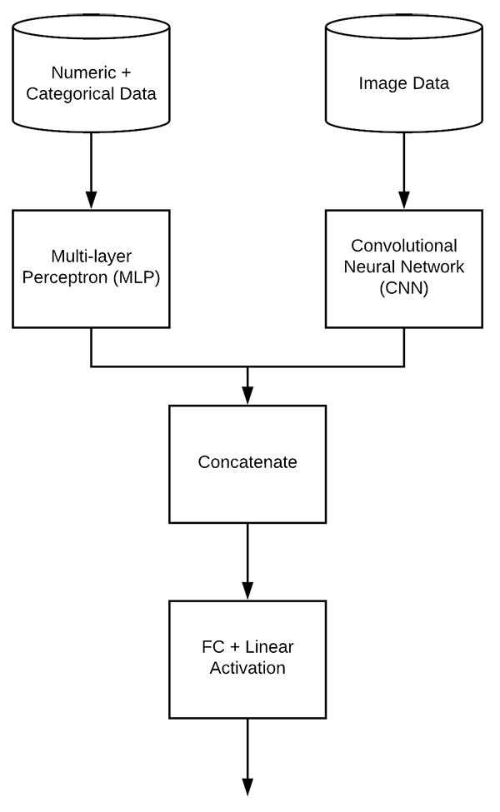
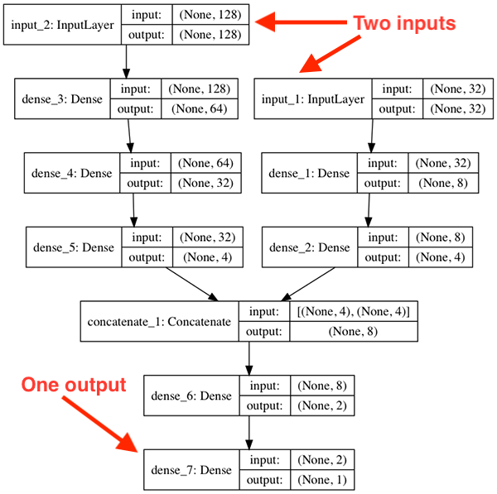
Predict
The maximum R² is about 0.2643 (Interest + Work + Country).
What if we joined them all together? And ran them through a Combined Model that took mixed inputs?

Slide 63
Predict
Mixed Input Model
The maximum R² is about 0.2643 (Interest + Work + Country).
What if we joined them all together? And ran them through a Combined Model that took mixed inputs?

Slide 64
Predict
Hyper parameters

Slide 65
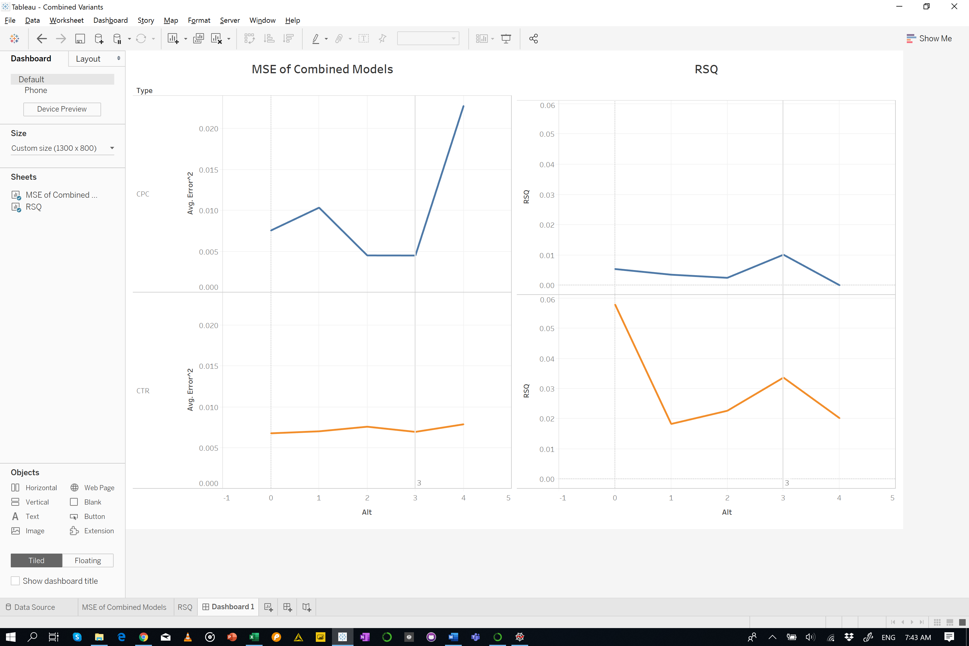
Predict
Combined Models MSE & RSQ
Hyper parameters

Slide 66
Predict
Combined Models MSE & RSQ
Best performing model only provided an R² of 0.057944 (iwc1 | CTR). Interestingly, the MSE is quite low at 0.00678

Slide 67
Predict
Mixed Input Model
Our prediction models are comparatively inferior (other Mixed Input Models get R² of 70%).
Fundamental issue in the data preparation or transformation?
Try all parameter sets?
Try with different hyper parameters?
Try Random Forests. Predict bins of CTR / CPC from Interest, Work, Countries, and Image Objects.

Slide 68

Next Steps…

Slide 69
Next Steps…
Data Cleaning | Data Transformation | Modeling & Prediction
Find the correlation ratio between features. Remove variables that are highly correlated to enforce independence | Use correlation ratio in K-means* algorithm to cluster them. Group work positions into broader categories (e.g. seniority) and use label (aka dummy) encoding on them? | Instead of selecting parameter sets based on their Linear Regression performance – try all parameter sets less than suggest features. E.g. Build models for each set of Interests[0…58] Try with different hyper parameters. Trial different types of layers in the Combined model
 | Try Random Forests. It can be used predict bins of CTR / CPC from Interest, Work, Countries, and Image Objects.
* Found a K-modes algorithm that might help with clustering

Slide 70

Thank You | Q&A

